Slide 1
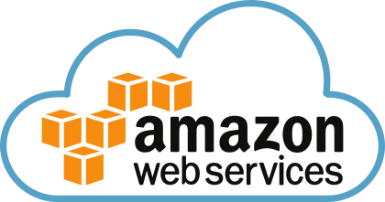
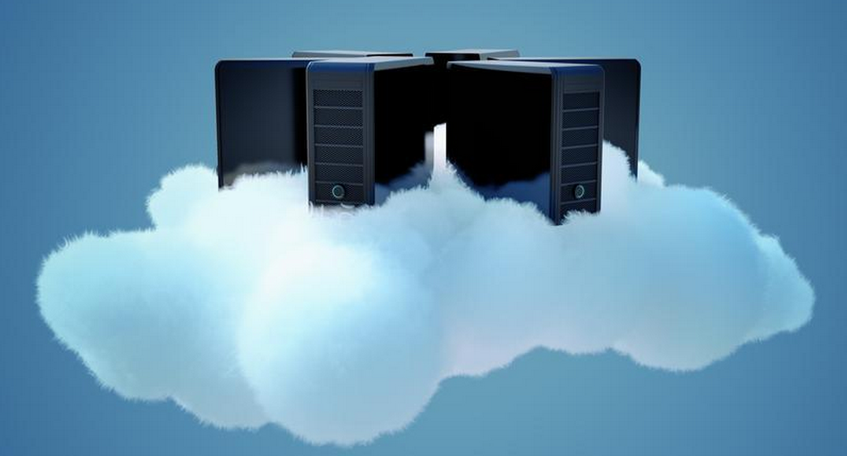

AWS Training - Session 9
Dr. Prabhakar PhD
Senior Integration Engineer
Decision Minds, Bengaluru.

Slide 2
Contents
Amazon Redshift– Hosting an application in cloud
Regardless of when you start your trial, you will receive 750 free hours per month for two full months.
DC2.Large features 16 GB RAM, 2 Cores, 160 GB compressed SSD storage.
Services for AWS Solution Architect Associate Exam
Amazon S3
Amazon Glacier
Amazon EC2
Amazon EBS
Amazon VPC
Elastic Load Balancing
Amazon CloudWatch
Auto Scaling
Amazon IAM
Amazon RDS
Amazon Redshift
Amazon DynamoDB
Amazon SQS
Amazon SWF
Amazon SNS
Amazon Route53
Amazon ElasticCache

Slide 3
Amazon Redshift vs. Amazon RDS
RDS available in MySQL, Aurora, Postgres etc. Its mainly used for transactional related application to store daily regular insert ,update and delete operations. (OLTP).
Amazon Redshift used for storing aggregated information for reports. Which holds history records also. (OLAP).
Amazon Relational Database Service (RDS) – AWS or Amazon Aurora – Relational Database Built for the Cloud - AWS are transactional and relational databases in AWS. RDS supports many DB engines like ORACLE, MySQL, Postgres, MSSQL, MariaDB.
Amazon Redshift – Data Warehouse Solution – AWS is a columnar MPP (massively parallel processing database)database. It is powered by PostgreSQL.

Slide 4
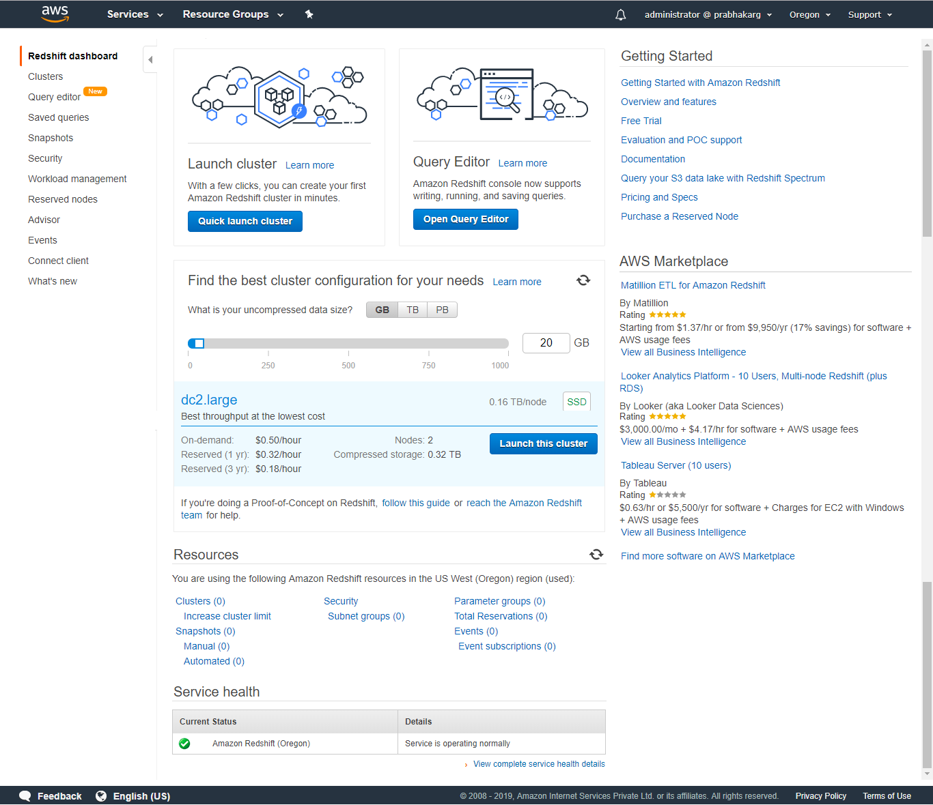
Deploying Redshift Cluster

Slide 5
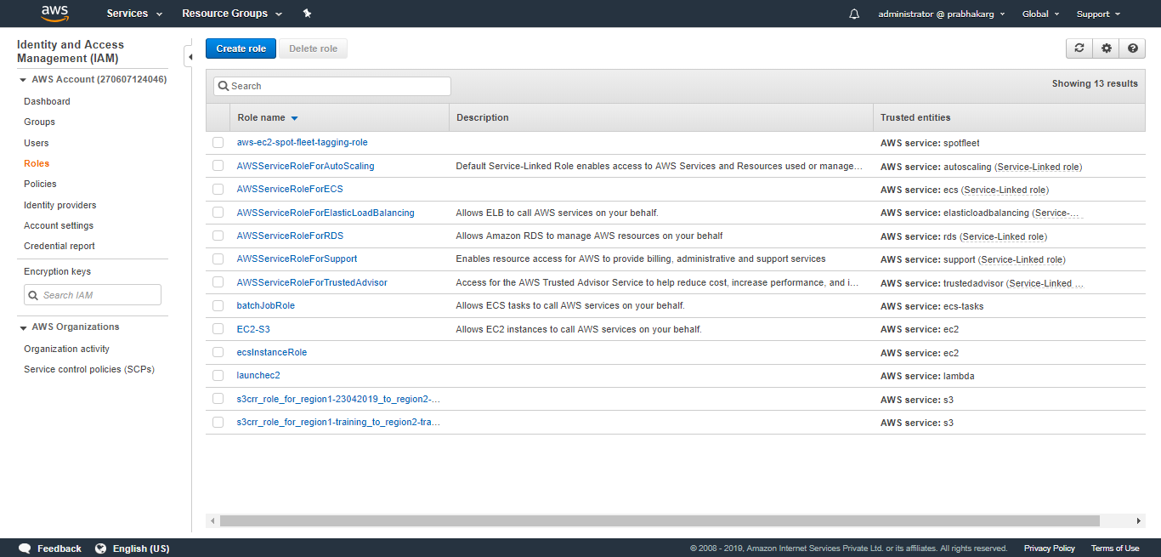

Slide 6
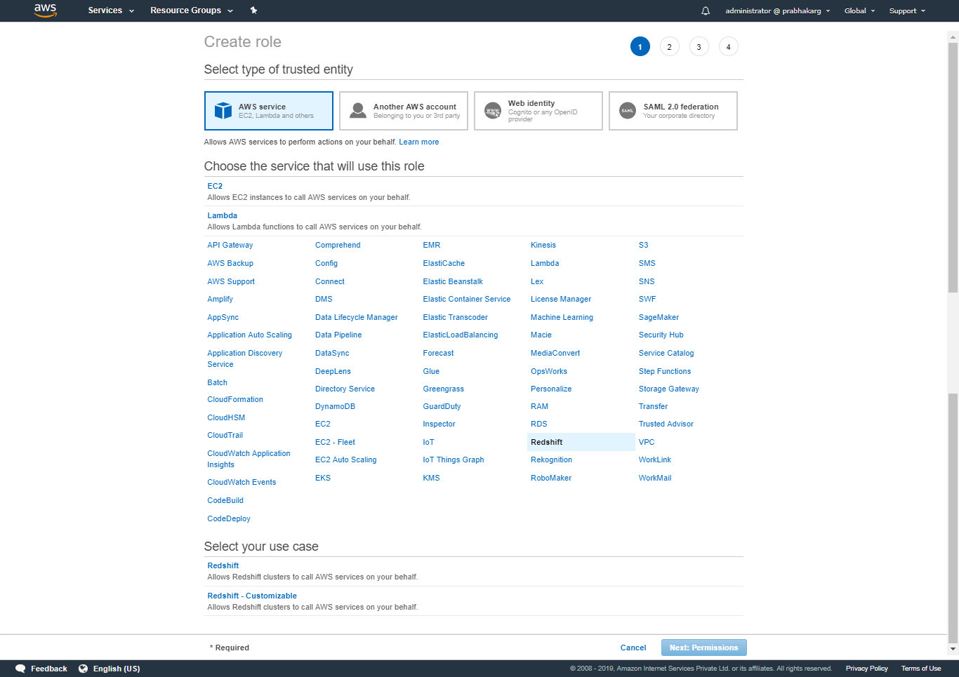

Slide 7
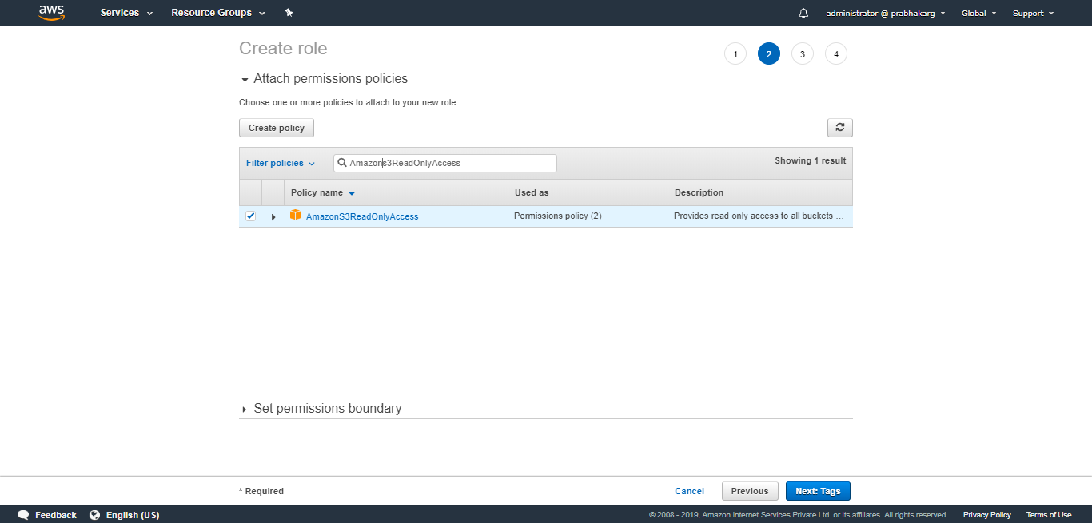

Slide 8
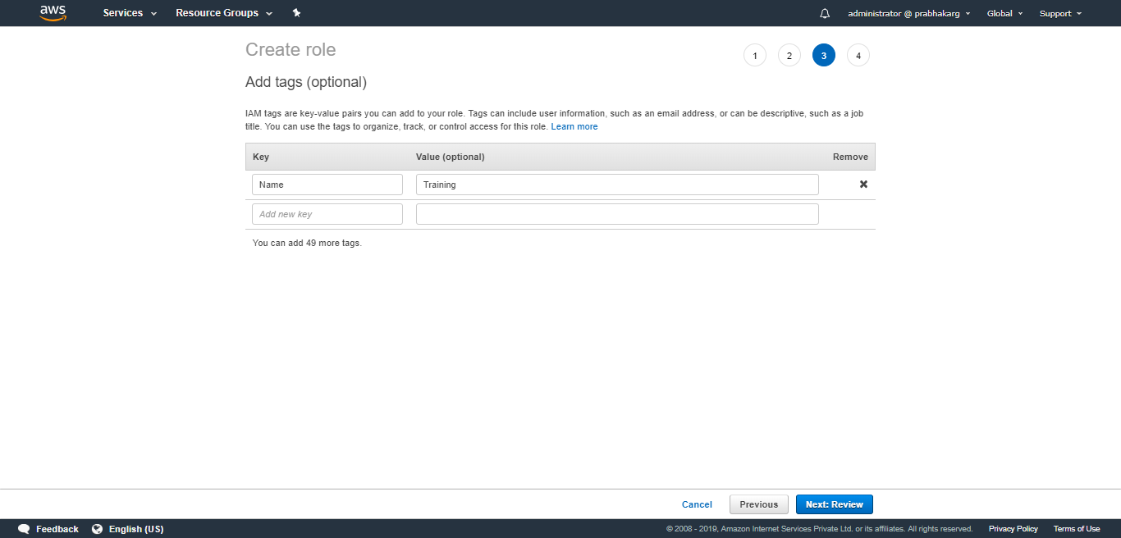

Slide 9
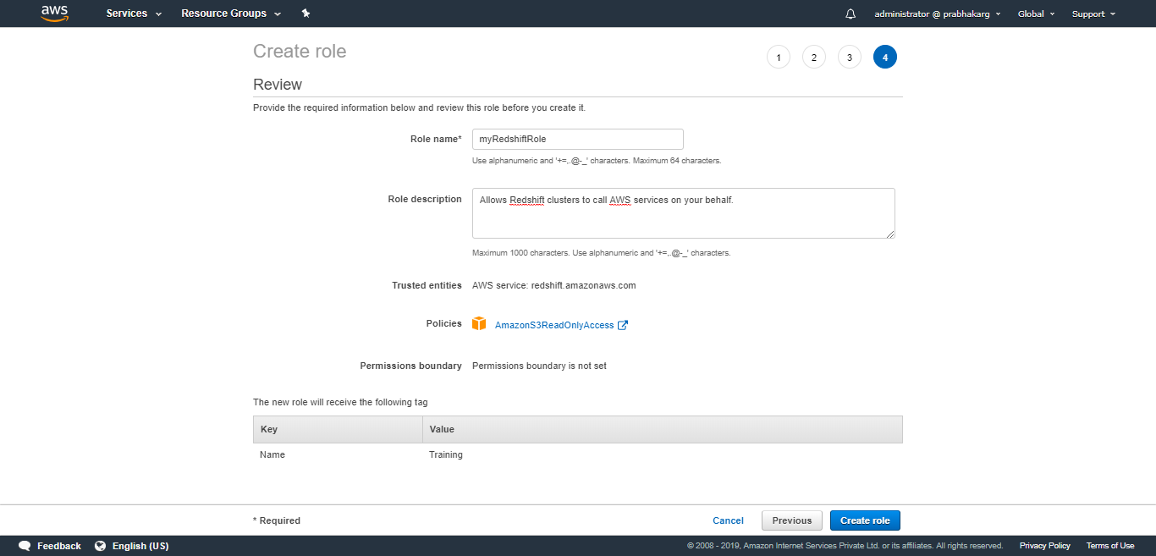

Slide 10
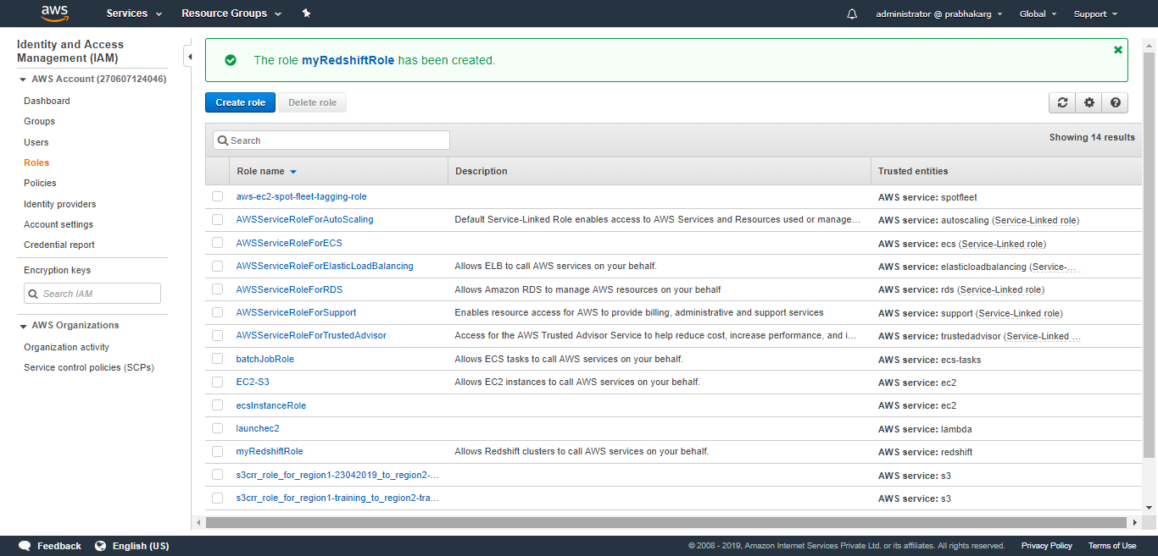

Slide 11
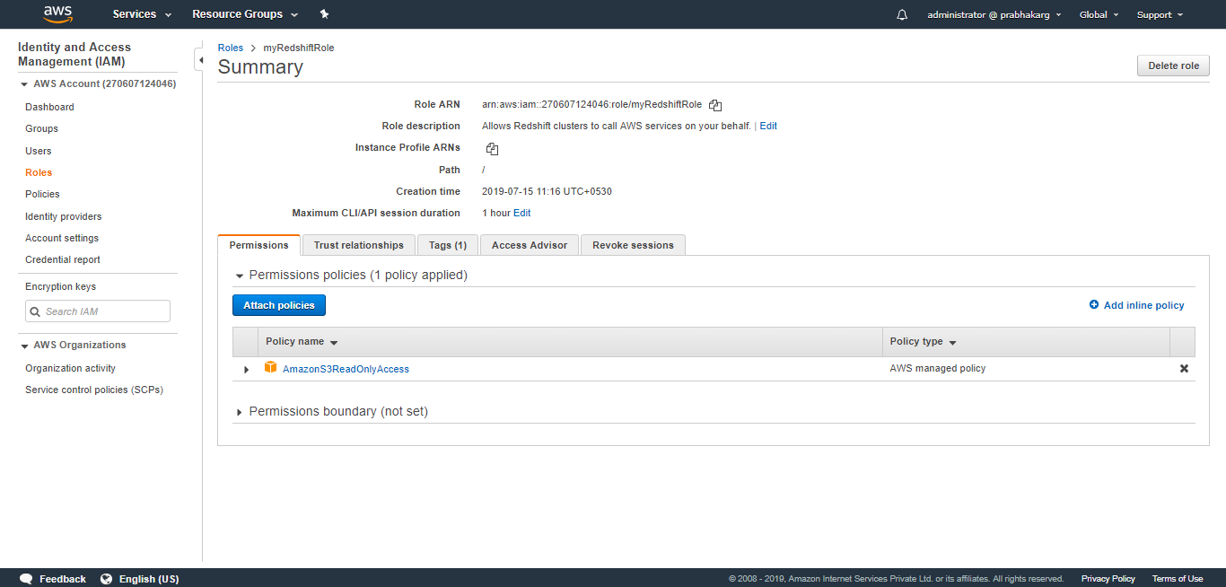

Slide 12
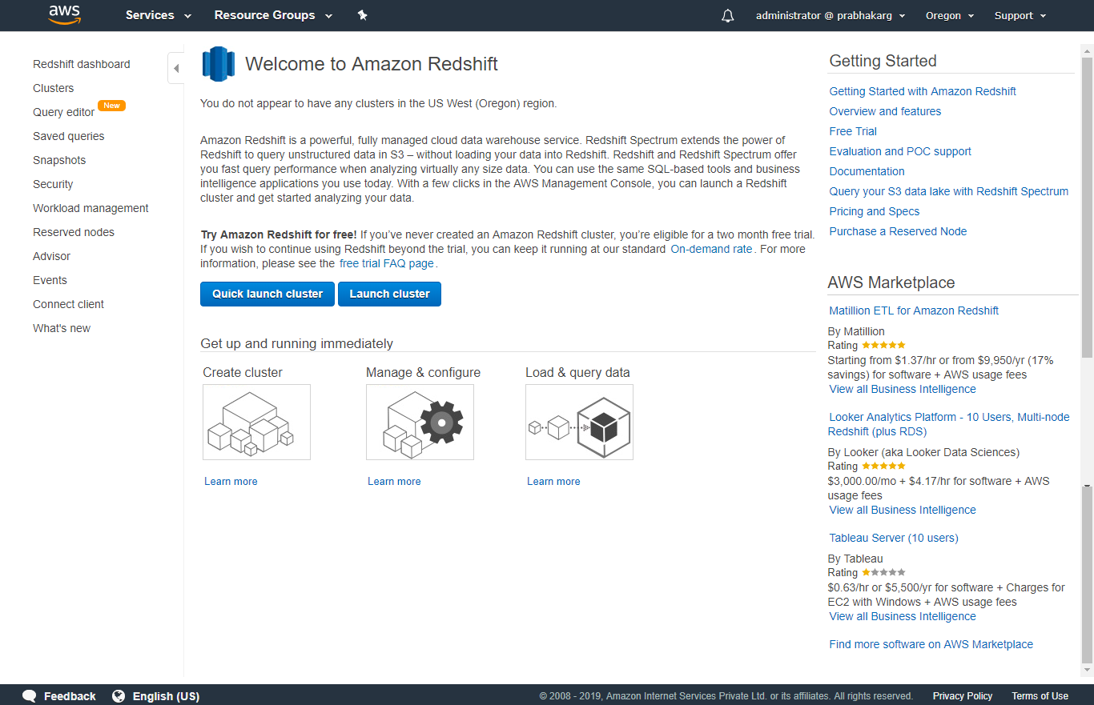

Slide 13
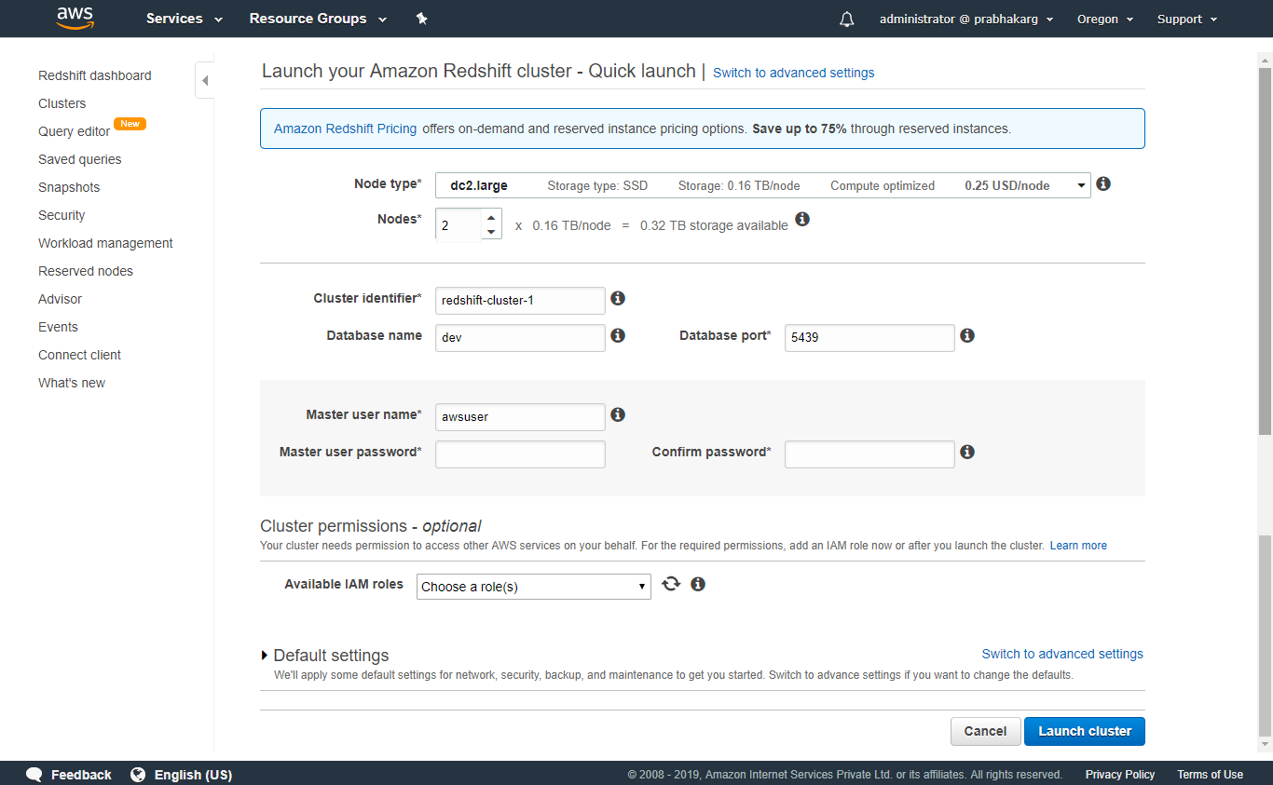

Slide 14
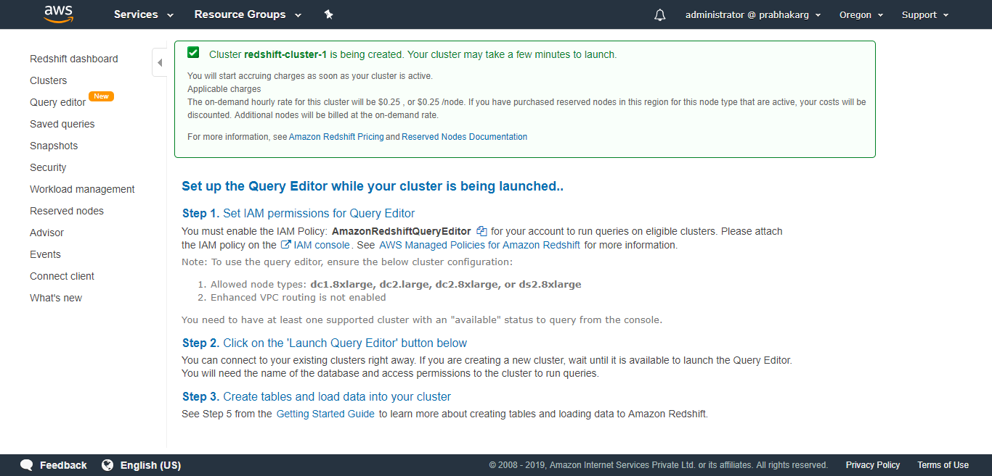

Slide 15
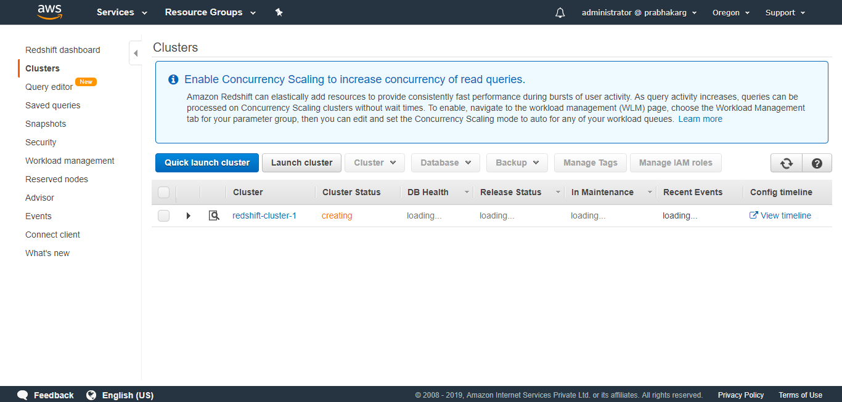

Slide 16
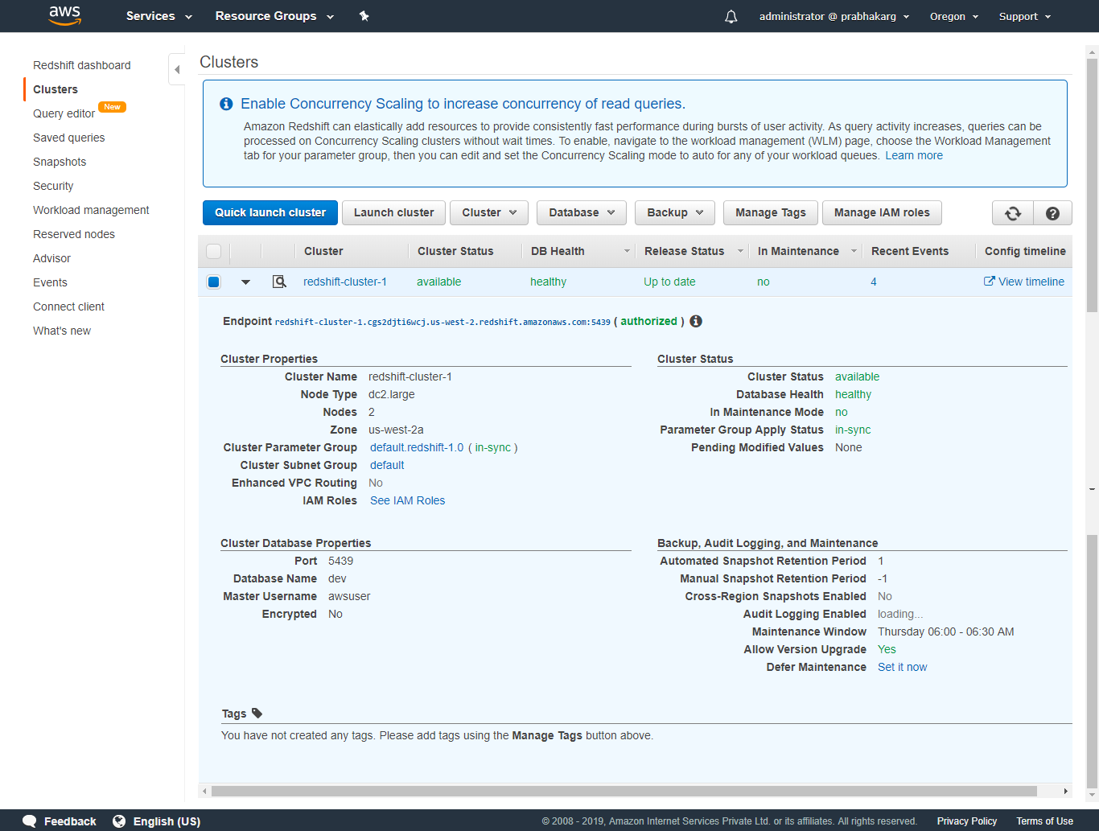

Slide 17
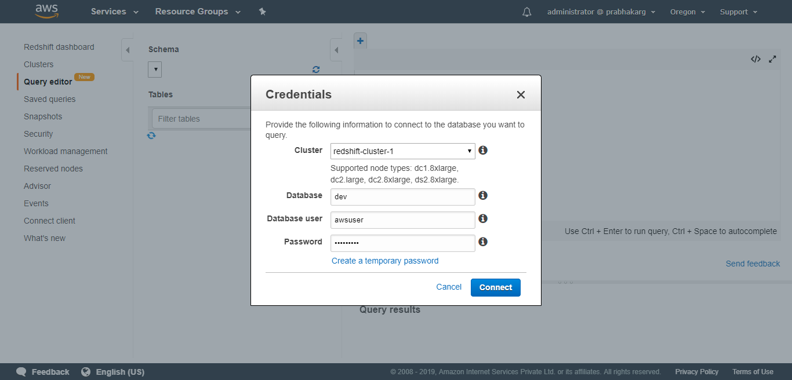

Slide 18
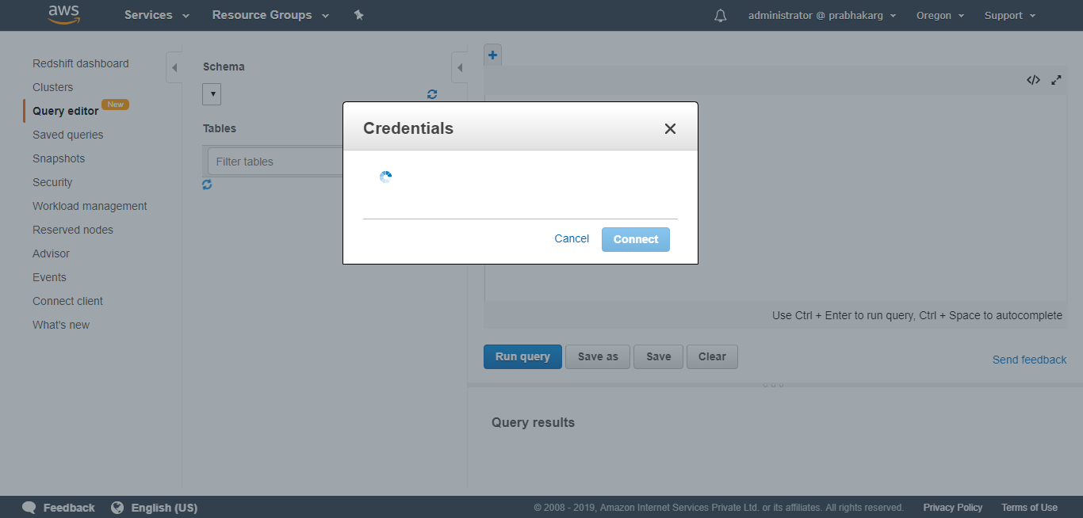

Slide 19
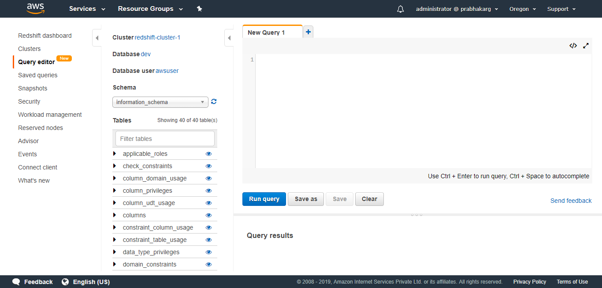

Slide 20
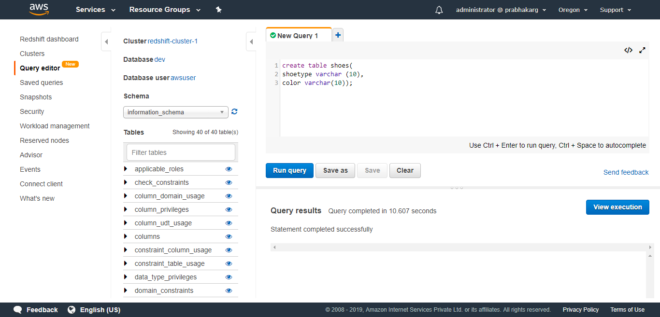

Slide 21


Slide 22
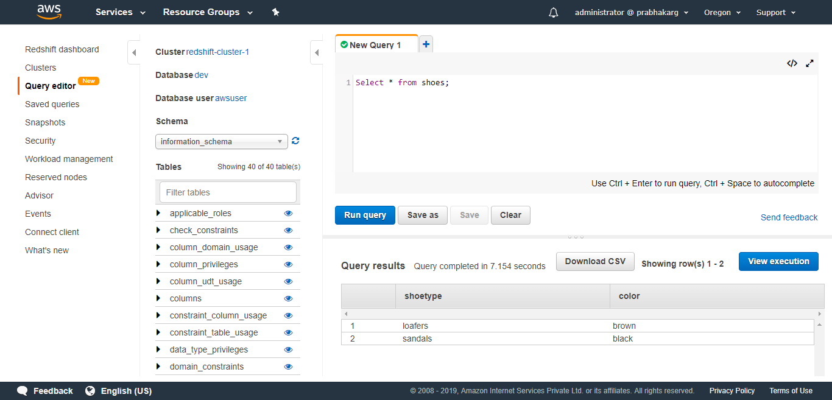

Slide 23
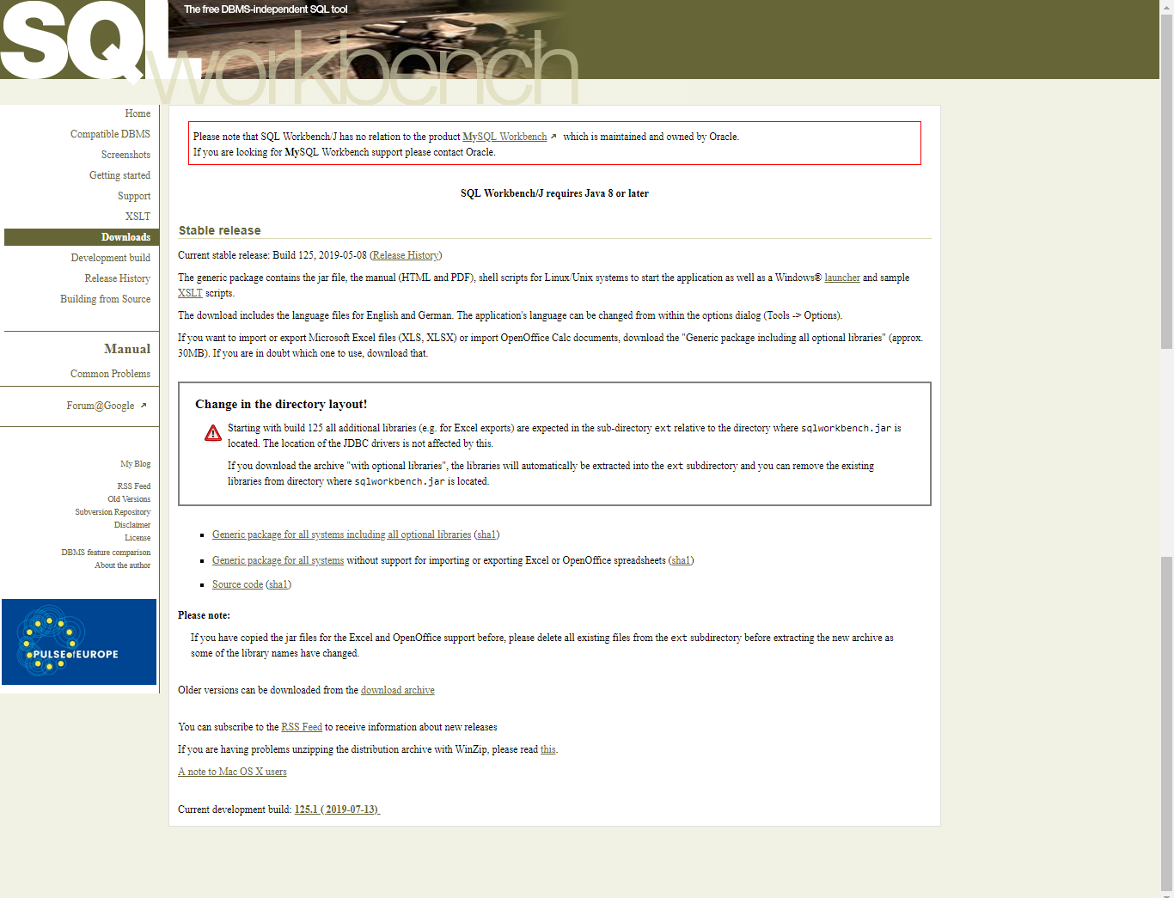
http://www.sql-workbench.eu/

Slide 24
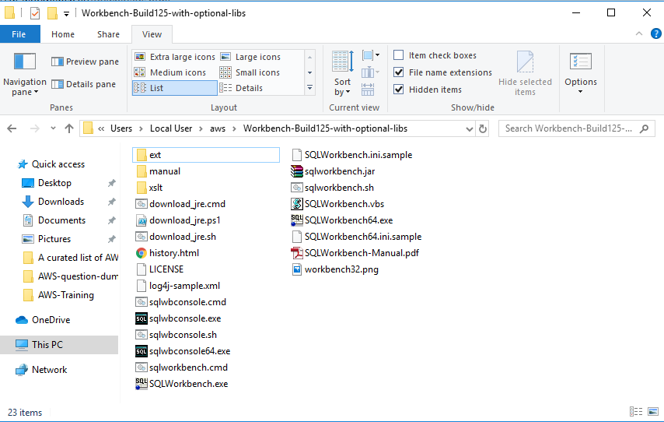

Slide 25
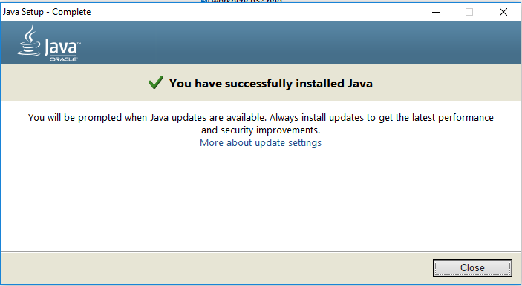

Slide 26
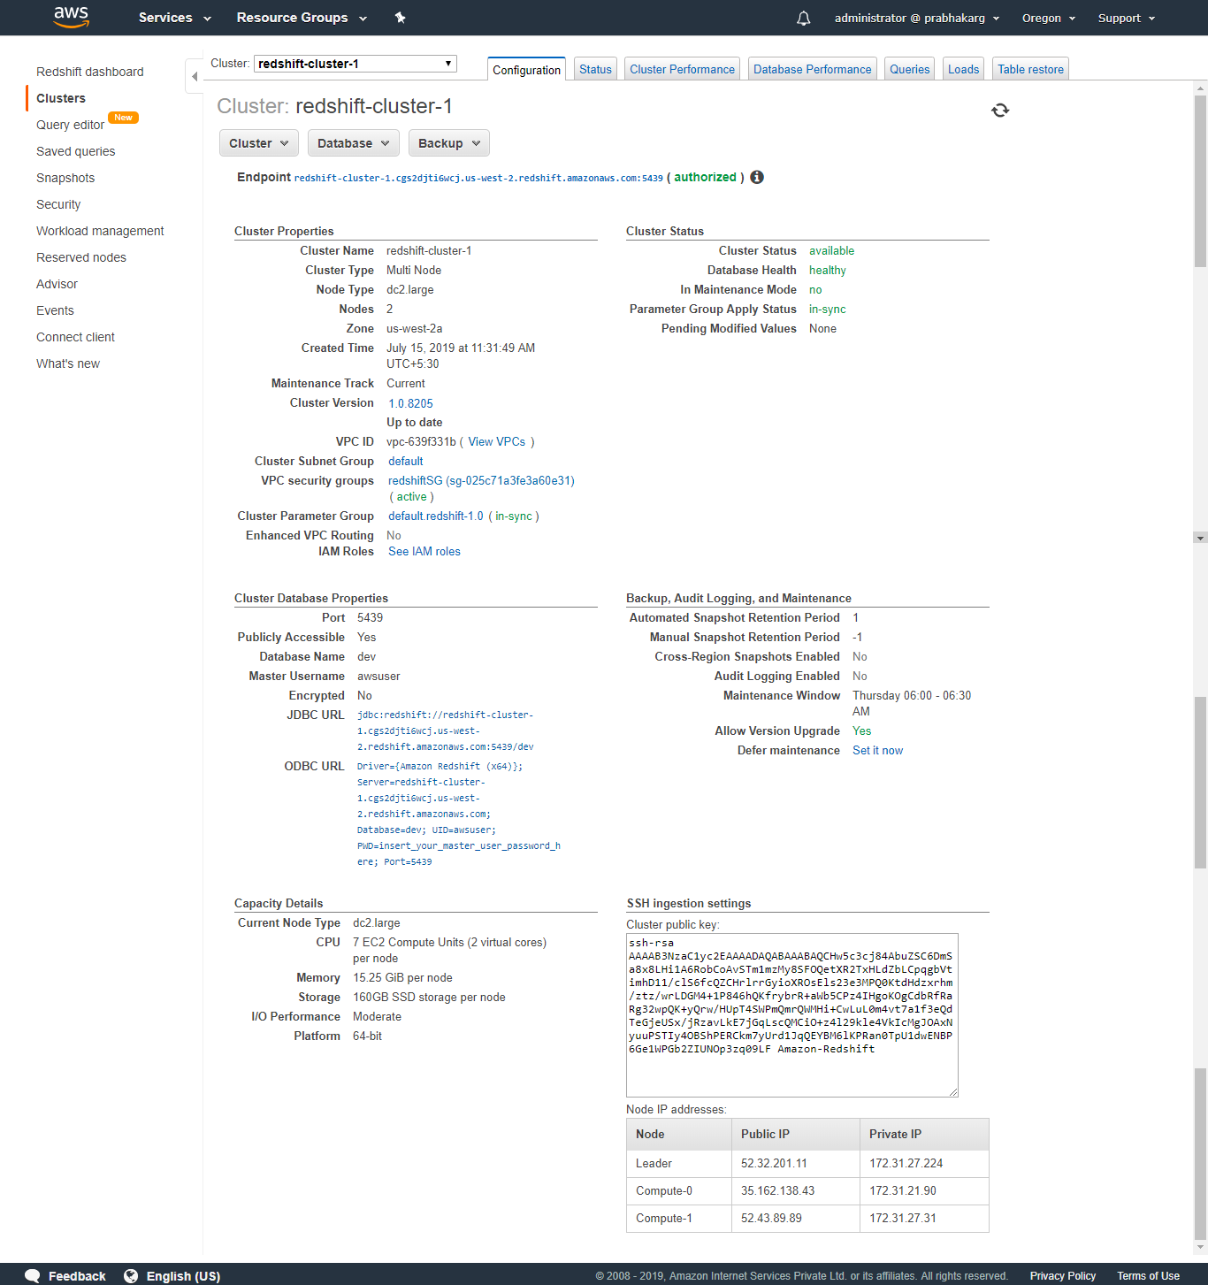

Slide 27
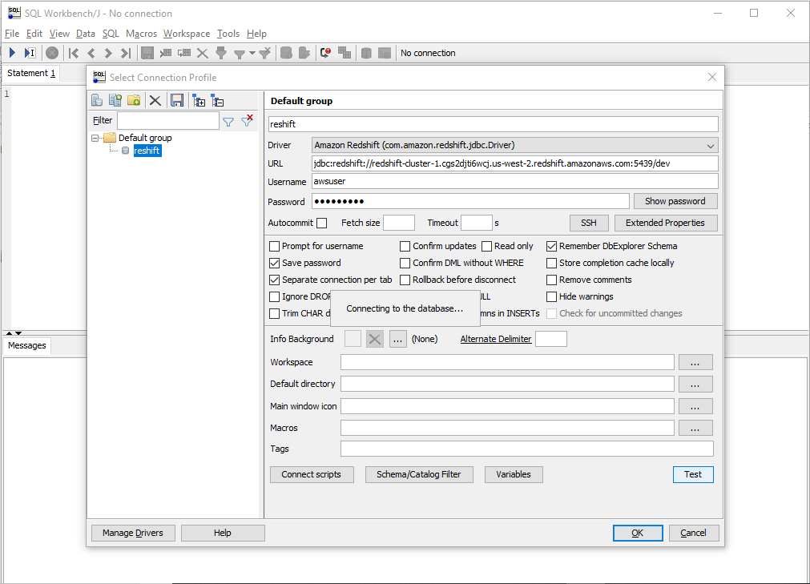

Slide 28
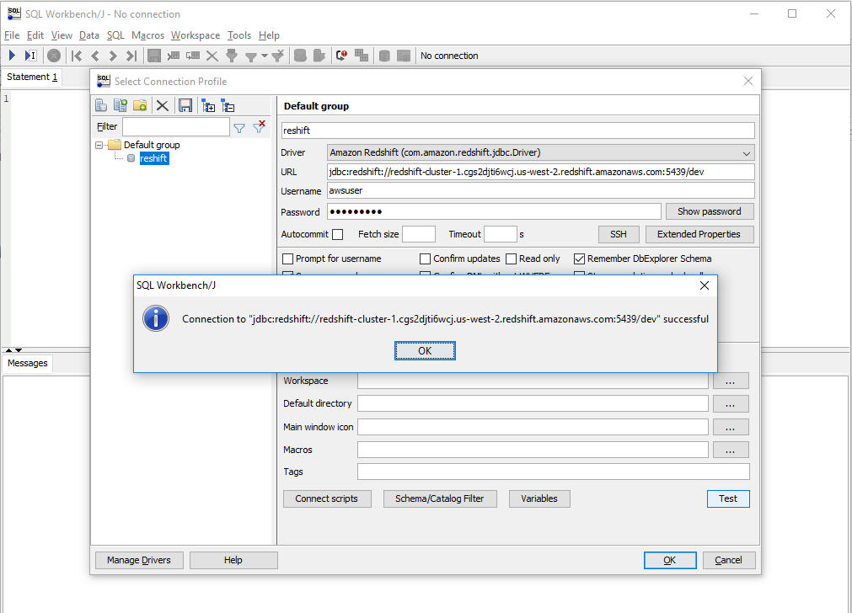

Slide 29
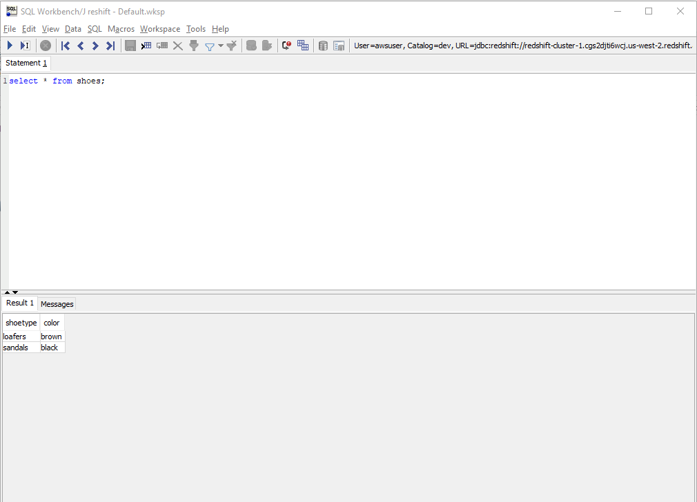

Slide 30
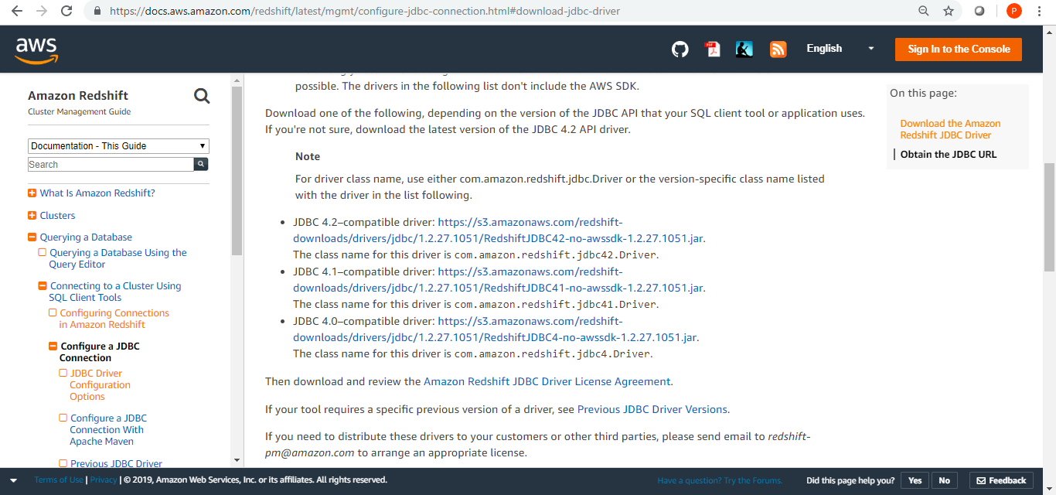

Slide 31
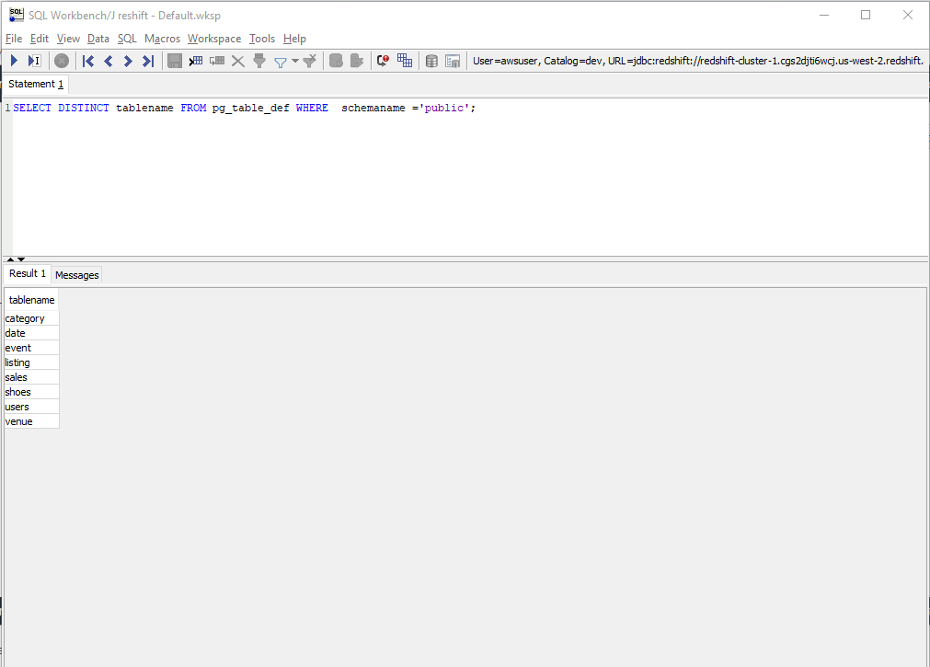

Slide 32
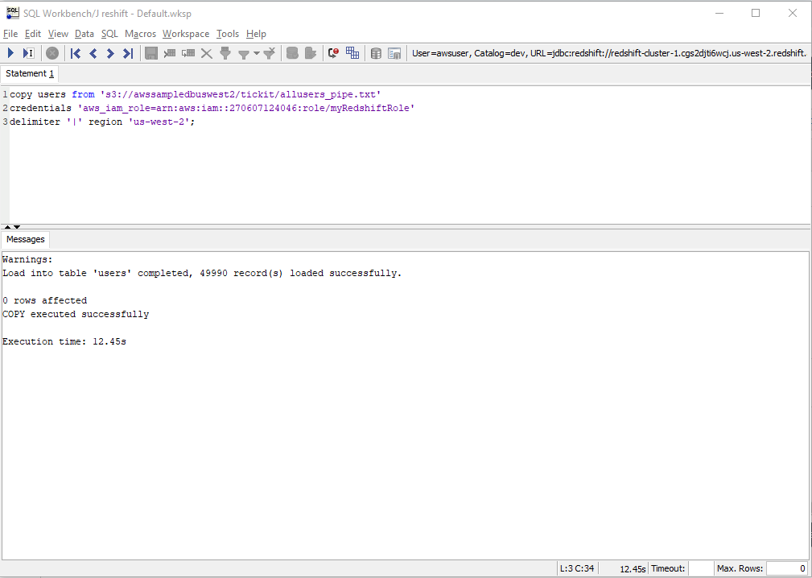

Slide 33
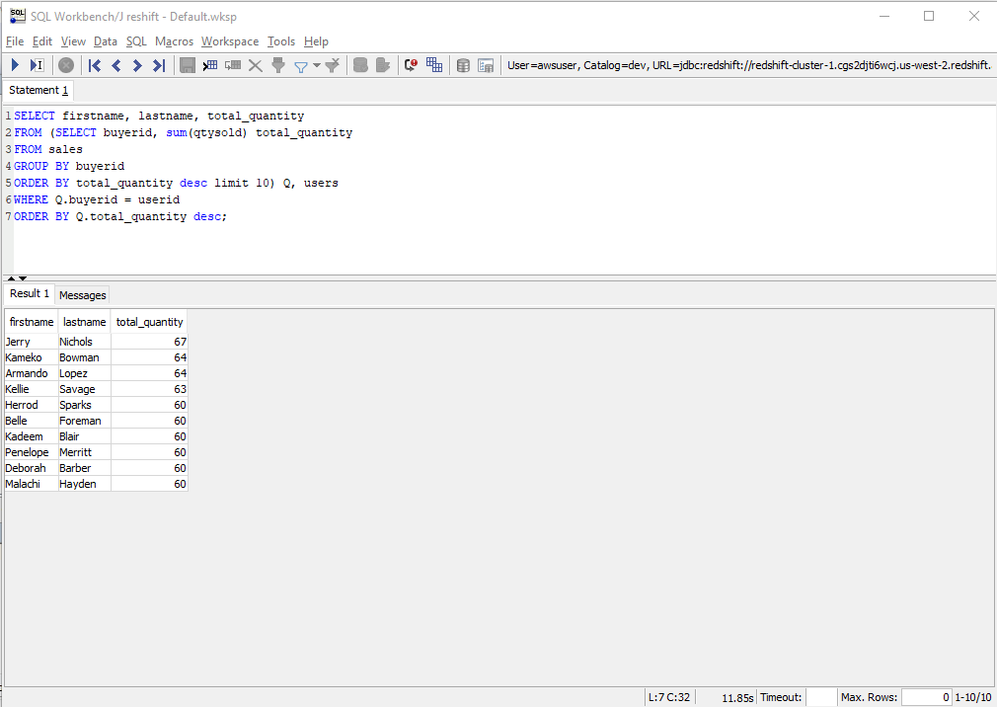

Slide 34
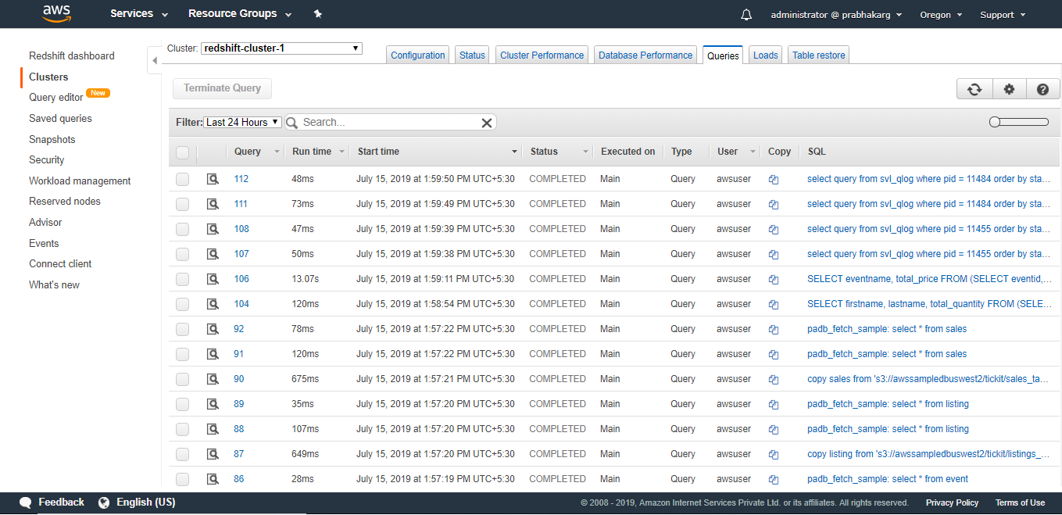

Slide 35
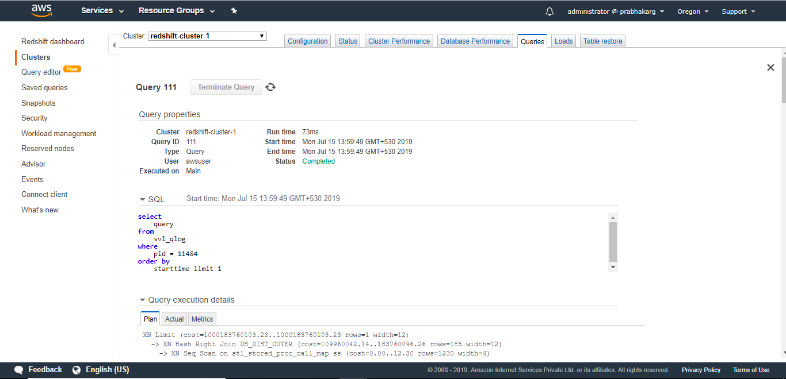

Slide 36
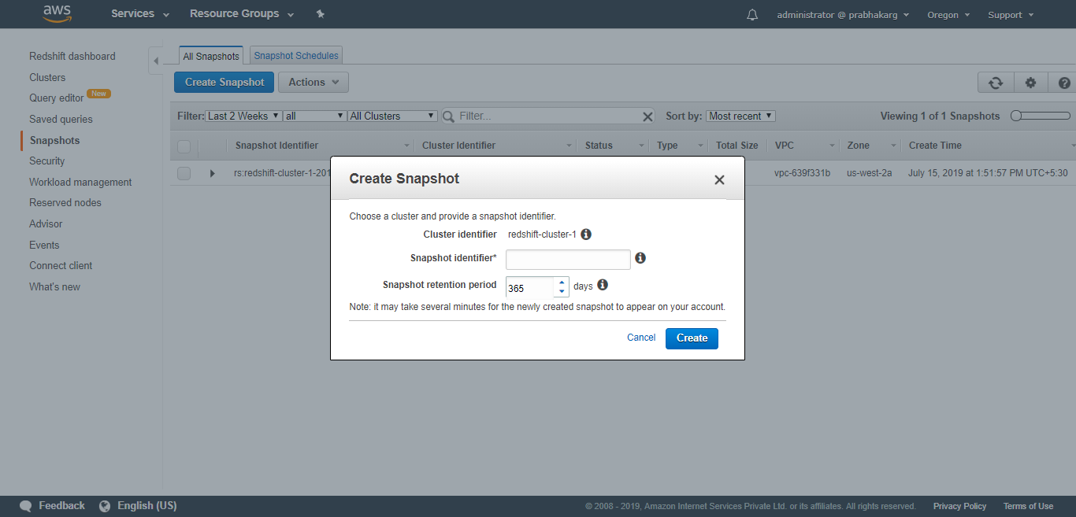

Slide 37
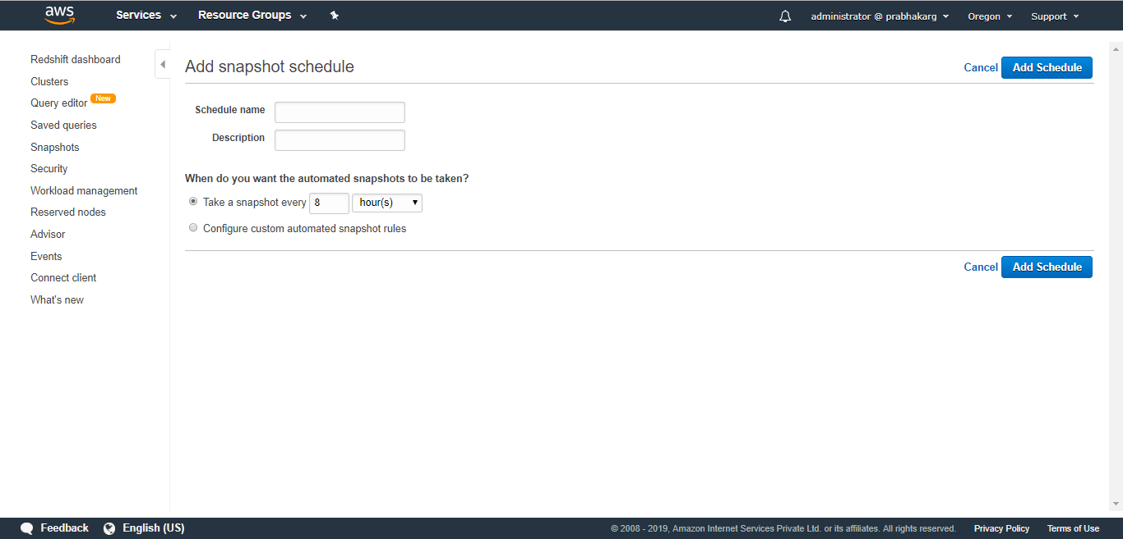

Slide 38
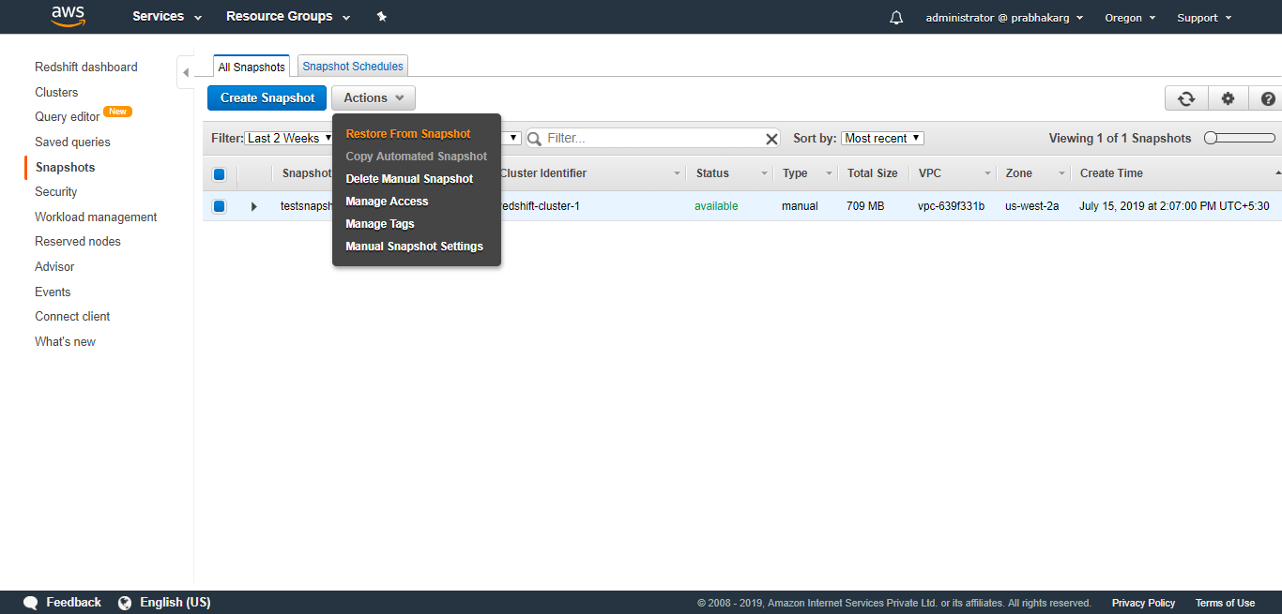

Slide 39
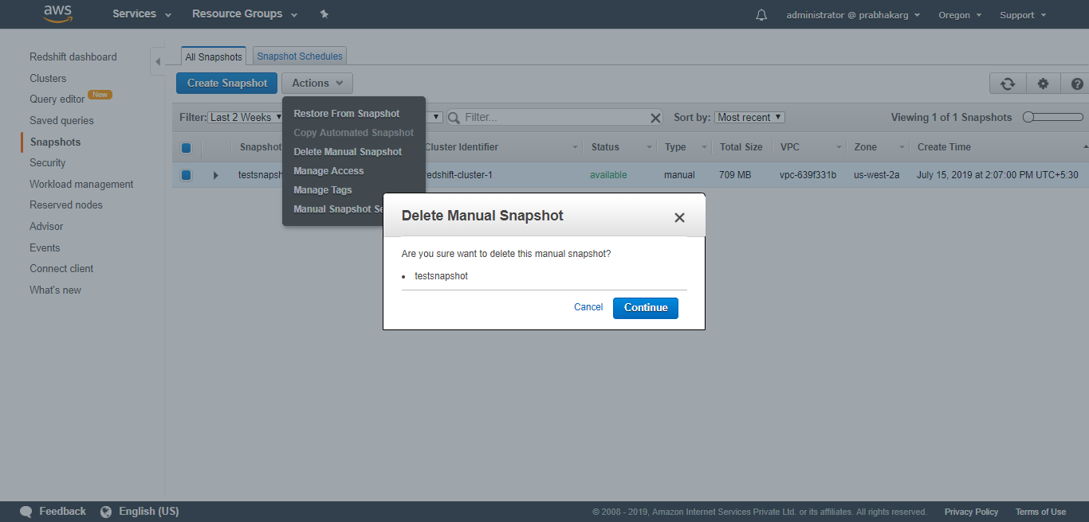

Slide 40
Thank you

